Slide 1

Raining Cats and Dogs by Pets R Us
Richard Nelson
Christopher Saechao
Ruxin Qu
Lely Huynh

Slide 2
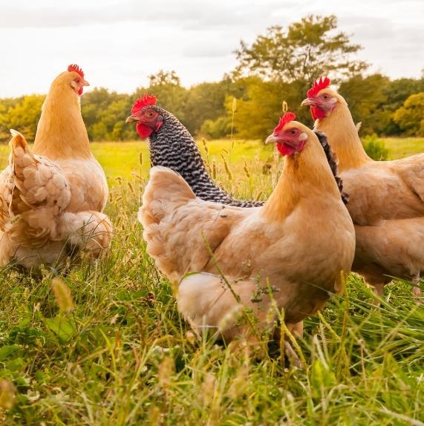
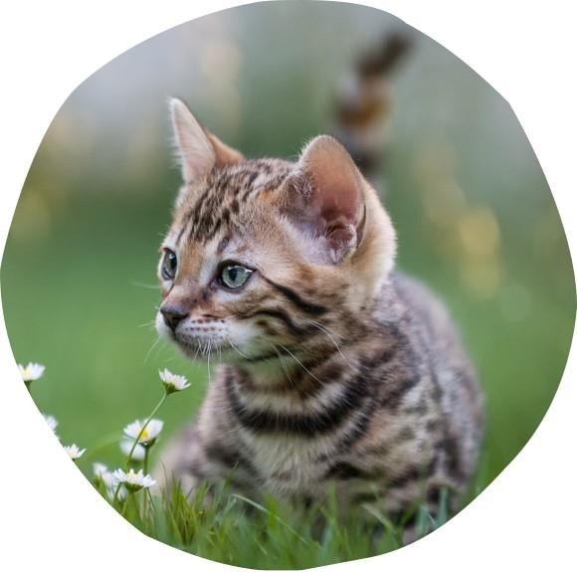
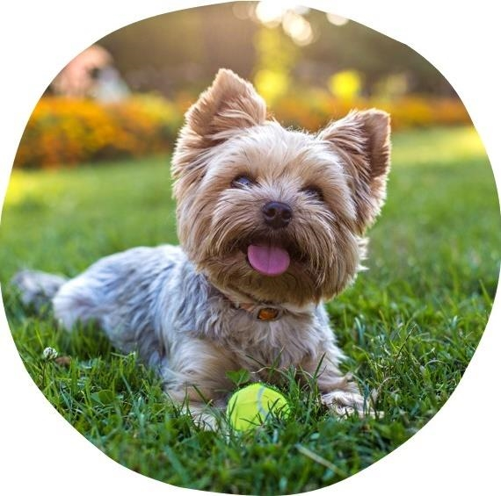
Elevator Pitch
Raining Cats and Dogs is created to help pet owners find temporarily places for their pets to stay so that the owners can take their vacation in ease knowing that their pet will be taken care of while being away.

Slide 3
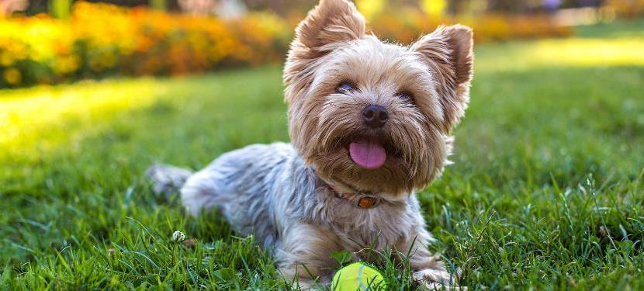
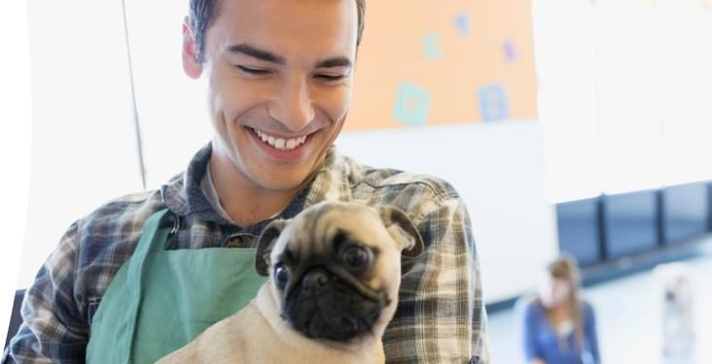
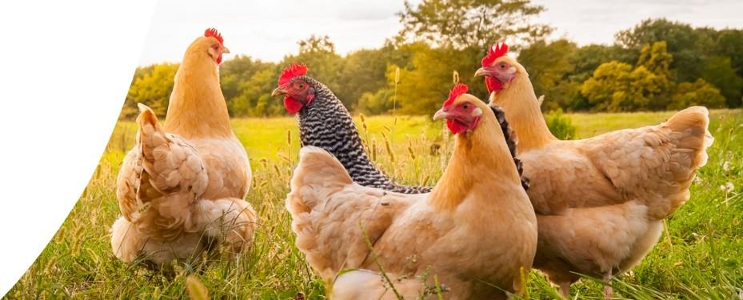
Concept
As a busy pet owner, who’s planning for a trip, I’d like one site to collect all of the options for keeping track of my pets and providing options for overnight stay.
Raining Cats and Dogs allows users to create their own account, then add and save their pets so they can be checked into any of the available hotels our site has to offer.

Slide 4
Process
Technologies Used
Express
Mocha
Chai
Supertest
WebdriverIO
Passport-local
Bcrypt
Express-Handelbars
Sequelize
Mysql2
Breakdown of Tasks and Roles
Richard – Backend, modules, seeds, routes
Christopher – CSS styling, Backend
Ruxin – Authentication, back/front end
Lely – Front end, Handlebars
Challenges
Bulma fonting to display correctly
Random background changes to refresh every time screen changes
Successes
Creating an interactive picture when cursor are on username/password
Able to create new pets to add on file
Random dog image when clicking anywhere on the screen

Slide 5
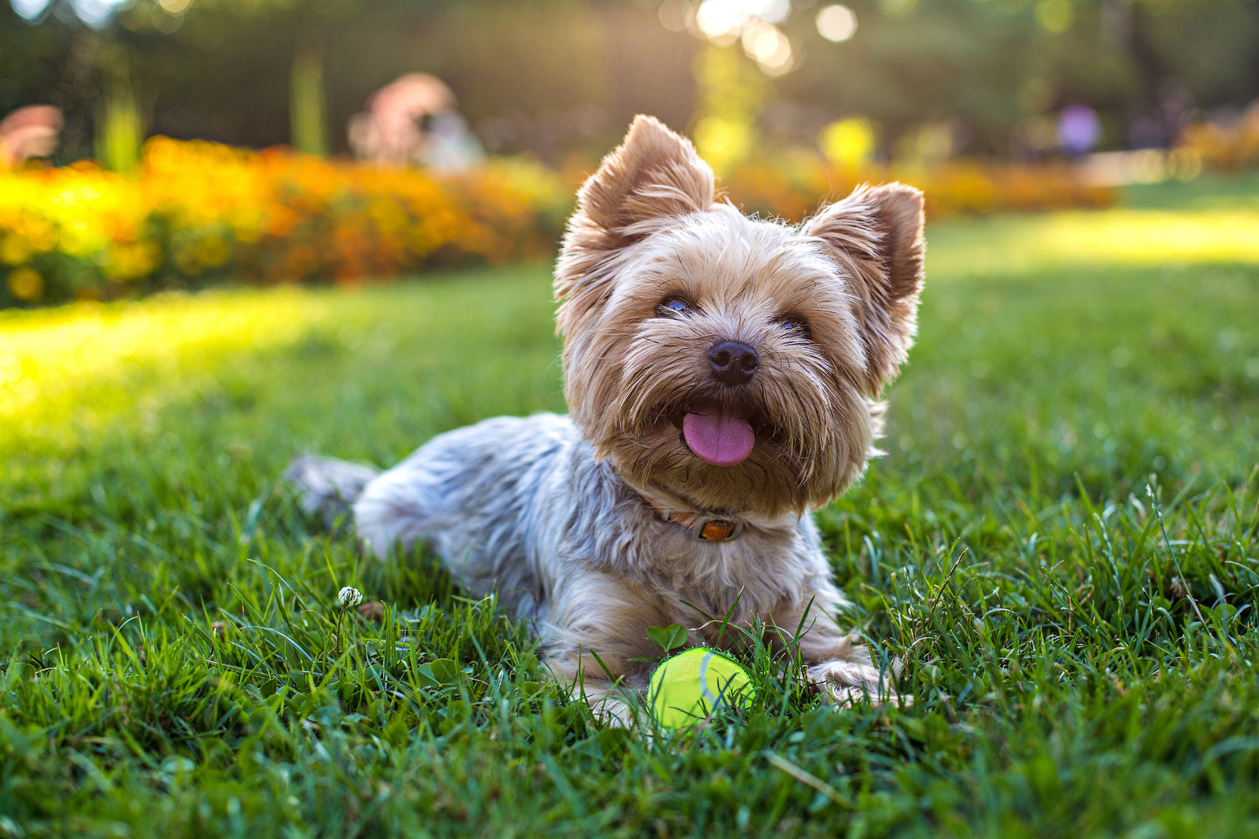
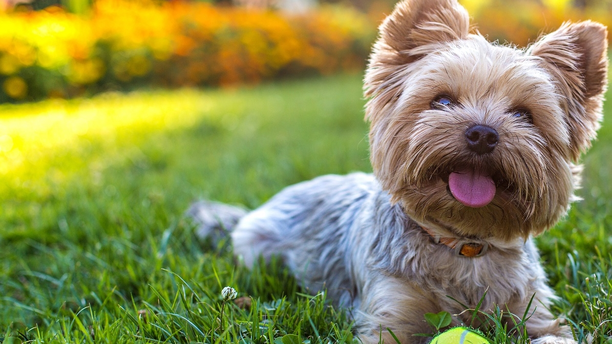
Demo

Slide 6
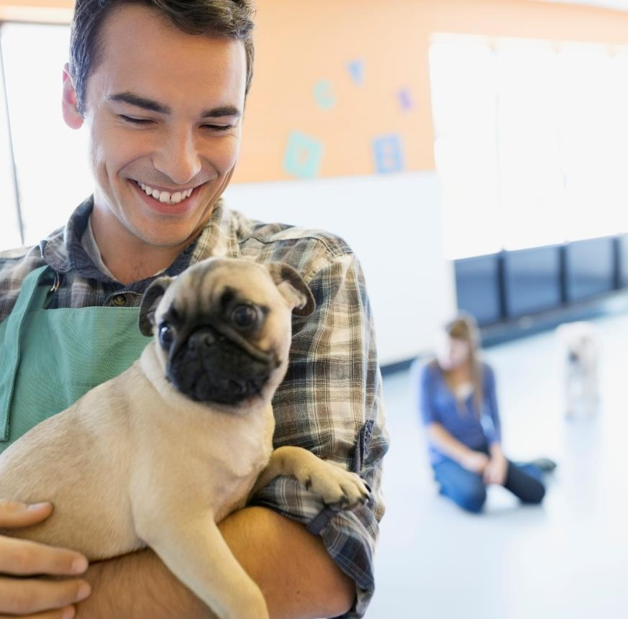
Directions for Future Development
Able to change password
Owners able to upload their pet’s pictures
Owners can choose how long the pet needs to stay in the hotel
Owners can choose specific dates
Owners able to see and leave review
Set hotel maximum occupancy
Map API to go live to search and book on live sites

Slide 7
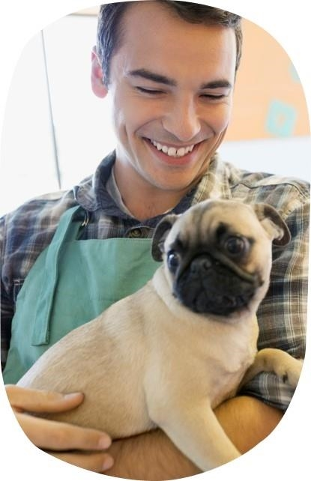
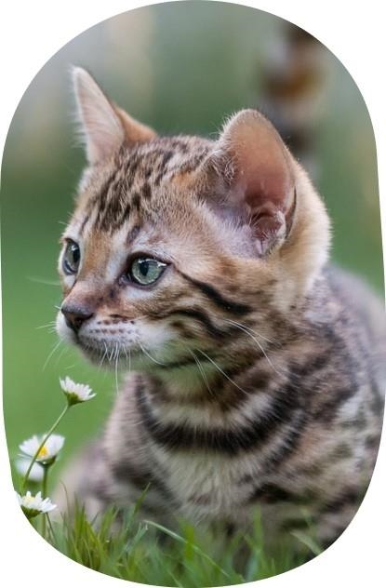
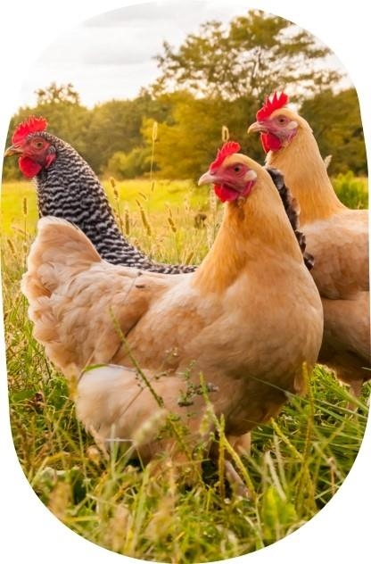
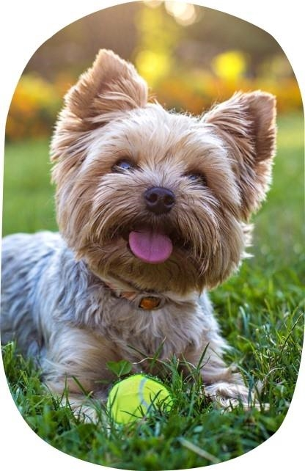
Thank you
Raining Cats and Dogs By Pets R Us
Github Repo: https://github.com/TikoMyster/Raining-Cats-and-Dogs
Deployed website: https://raining-cats-dogs.herokuapp.com/

